Slide 1
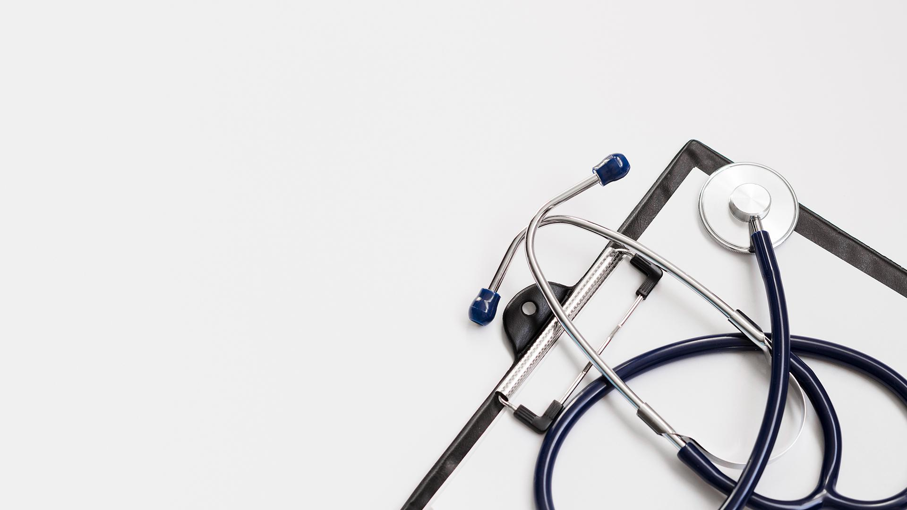
Cephalometric
Landmark
Detection
-Pranshu Choubey (20BAI1069)

Slide 2
Table of Contents
1. | Introduction of the Problem Statement
2. | Contributions
3. | Research Design
4. | Data Source
5. | Methodology: Preprocessing Techniques, Feature Extraction Methods, Classification Models
6. | Hardware Requirements
7. | Results
8. | Conclusion
9. | References

Slide 3

Introduction of the Problem Domain
Cephalometric landmark detection plays a crucial role in orthodontic and oral and maxillofacial surgical treatments. However, conventional methods for landmark detection are time-consuming, subjective, and prone to errors. To address these limitations, machine learning algorithms have emerged as a promising solution.
This presentation focuses on the use of machine learning algorithms for cephalometric landmark detection and their potential to improve the efficiency and accuracy of cephalometric analysis. We will discuss the challenges faced by conventional methods, the advantages of machine learning algorithms, and the findings of our study, which compared the performance of different algorithms using a dataset of cephalometric radiographs.
Additionally, we will explore the limitations of our study and propose future research directions to enhance the reliability and applicability of machine learning algorithms in cephalometric landmark detection. Overall, this presentation aims to contribute to the advancement of cephalometric landmark detection and highlight the potential of machine intelligence in the field of medical image analysis.

Slide 4

Project Work Timeline:
Review: 1
Review: 2
Review: 3
Conducted a comprehensive literature review on cephalometric landmark detection, summarizing key findings and providing valuable insights. Conducted various stages of data preprocessing, feature extraction, and model evaluation.
Acquired and organized the dataset, ensuring its quality and suitability for the project. Conducted thorough data analysis, visualization, and statistical tests, providing valuable insights into the performance of different models.
Conducted in-depth research on the challenges and limitations in cephalometric landmark detection, contributing to the discussion section and future research directions.

Slide 5
Research Design
The study employed a quantitative research design to compare the performance of different machine learning algorithms for cephalometric landmark detection. This design allowed for the objective measurement and evaluation of the algorithms' accuracy, precision, recall, and F1-score.
The dataset used in the study consisted of 150 cephalometric radiographs and their corresponding landmark annotations. These radiographs were obtained from a publicly available dataset on Kaggle, which provided a novel and challenging dataset for the problem of cephalometric landmark detection.
To prepare the dataset for analysis, various preprocessing techniques were applied. This included resizing the images to a resolution of 1935 x 2400 pixels, converting them to PNG format, and normalizing the intensity values. Additionally, the landmark annotations were provided in CSV format, with 19 columns representing the x and y coordinates of 19 landmarks on each image.

Slide 6

In terms of feature extraction, the study explored different methods, including Histogram of Oriented Gradients (HOG), Scale-Invariant Feature Transform (SIFT), and Local Binary Patterns (LBP). These methods aimed to capture shape and texture information from the images, enhancing the algorithms' ability to detect and locate the cephalometric landmarks accurately.
For classification, various models were employed, such as Support Vector Machine (SVM) and K-Nearest Neighbors (KNN). These models were trained on the dataset to learn the patterns and relationships between the extracted features and the landmark annotations. The performance of each model was evaluated using metrics such as accuracy, precision, recall, and F1-score.
By utilizing this quantitative research design, the study was able to systematically compare the performance of different machine learning algorithms for cephalometric landmark detection. The dataset, preprocessing techniques, feature extraction methods, and classification models all played crucial roles in evaluating the accuracy and effectiveness of the algorithms.

Slide 7

Data Source
These landmarks are crucial for cephalometric analysis and include:
Sella (S)
Nasion (N)
Orbitale (Or)
Porion (Po)
Subspinale (A)
Supramentale (B)
Pogonion (Pg)
Menton (Me)
Gnathion (Gn)
Lower incisor root (LIR)
Upper lip (UL)
Lower lip (LL)
Subnasale (Sn)
Soft tissue pogonion (Pg')
Sella-nasion (SN)
Sella-subspinale (SA)
Sella-supramentale (SB)
Sella-pogonion (SP)
Sella-menton (SM)
The dataset used in this study, called Cephalometric landmarks, consists of 150 cephalometric x-ray images and their corresponding landmark annotations. The dataset was created by a Kaggle user named jiahongqian specifically for the Automatic Cephalometric X-Ray Landmark Detection Challenge.
The cephalometric radiographs in the dataset are in PNG format and have a resolution of 1935 x 2400 pixels. This resolution ensures that the images contain sufficient detail for accurate landmark detection.
The landmark annotations provided in the dataset are in CSV format and consist of 19 columns representing the x and y coordinates of 19 specific landmarks on each image.
These landmarks are essential for measuring and analyzing the craniofacial structure and growth, providing valuable information for orthodontic and oral and maxillofacial surgical treatments.
The dataset, with its high-resolution cephalometric radiographs and accurate landmark annotations, serves as a valuable resource for developing and evaluating machine learning algorithms for cephalometric landmark detection.

Slide 8

Methodology
The methodology of the study involved several preprocessing techniques, feature extraction methods, and classification models to improve the accuracy and performance of cephalometric landmark detection.

Slide 9
Preprocessing Techniques
Converting images to grayscale: This technique eliminates color information and focuses on the intensity values of the images, simplifying the analysis.
Normalizing images: The images were normalized to have zero mean and unit variance. This normalization improves the convergence and stability of the algorithms during training.
Augmenting images: Random rotations, translations, scaling, flipping, and noise were applied to the images. This augmentation increases the diversity and robustness of the data, enabling the algorithms to generalize better.
Aligning images: The Sella and Nasion landmarks were used as reference points to align the images. This alignment reduces the variability of head orientation and position, making the landmark detection more consistent.
Cropping images: Irrelevant background regions were removed, and the images were cropped to focus on the region of interest, which contains the cephalometric landmarks.

Slide 10
Feature Extraction Methods
Histogram of Oriented Gradients (HOG): This method computes the gradient magnitude and orientation of pixels in an image. It creates a histogram of the distribution of orientations in each cell of a grid, generating a feature vector that represents the shape and texture of the image.
Scale-Invariant Feature Transform (SIFT): SIFT detects and describes key points or interest points in an image that are invariant to scale, rotation, and illumination changes. Keypoints are located at local extrema of the difference of Gaussian function and assigned an orientation and descriptor based on neighboring pixel gradients. Descriptors are matched across images to find correspondences.
Local Binary Patterns (LBP): LBP assigns a binary code to each pixel based on the comparison of its intensity value with neighboring pixels. These binary codes are used to create histograms of code occurrences in image regions, forming a feature vector that represents texture and pattern information.

Slide 11
Classification Models
Support Vector Machine (SVM):
SVM finds a hyperplane that separates data points of different classes with the maximum margin. It can use a kernel function to map data points to a higher-dimensional space for better separation. SVM handles both binary and multiclass classification problems.
K-Nearest Neighbors (KNN):
KNN assigns a class label to a new data point based on the majority vote of its k nearest neighbors in the feature space. Different distance metrics, such as Euclidean, Manhattan, or Minkowski, can be used to measure similarity. KNN handles both binary and multiclass classification problems.
These preprocessing techniques, feature extraction methods, and classification models were applied to the dataset to enhance the accuracy and performance of cephalometric landmark detection.

Slide 12
Hardware Requirements
To run the machine learning algorithms for cephalometric landmark detection, you will need a computer with the following specifications:
A processor with at least 4 cores and 2.5 GHz speed.
A memory of at least 8 GB RAM.
A disk space of at least 100 GB.
A graphics card with at least 2 GB VRAM and CUDA support.
These hardware requirements are necessary to ensure smooth and efficient execution of the machine learning algorithms and to handle the computational demands of the image processing tasks involved in cephalometric landmark detection.

Slide 13
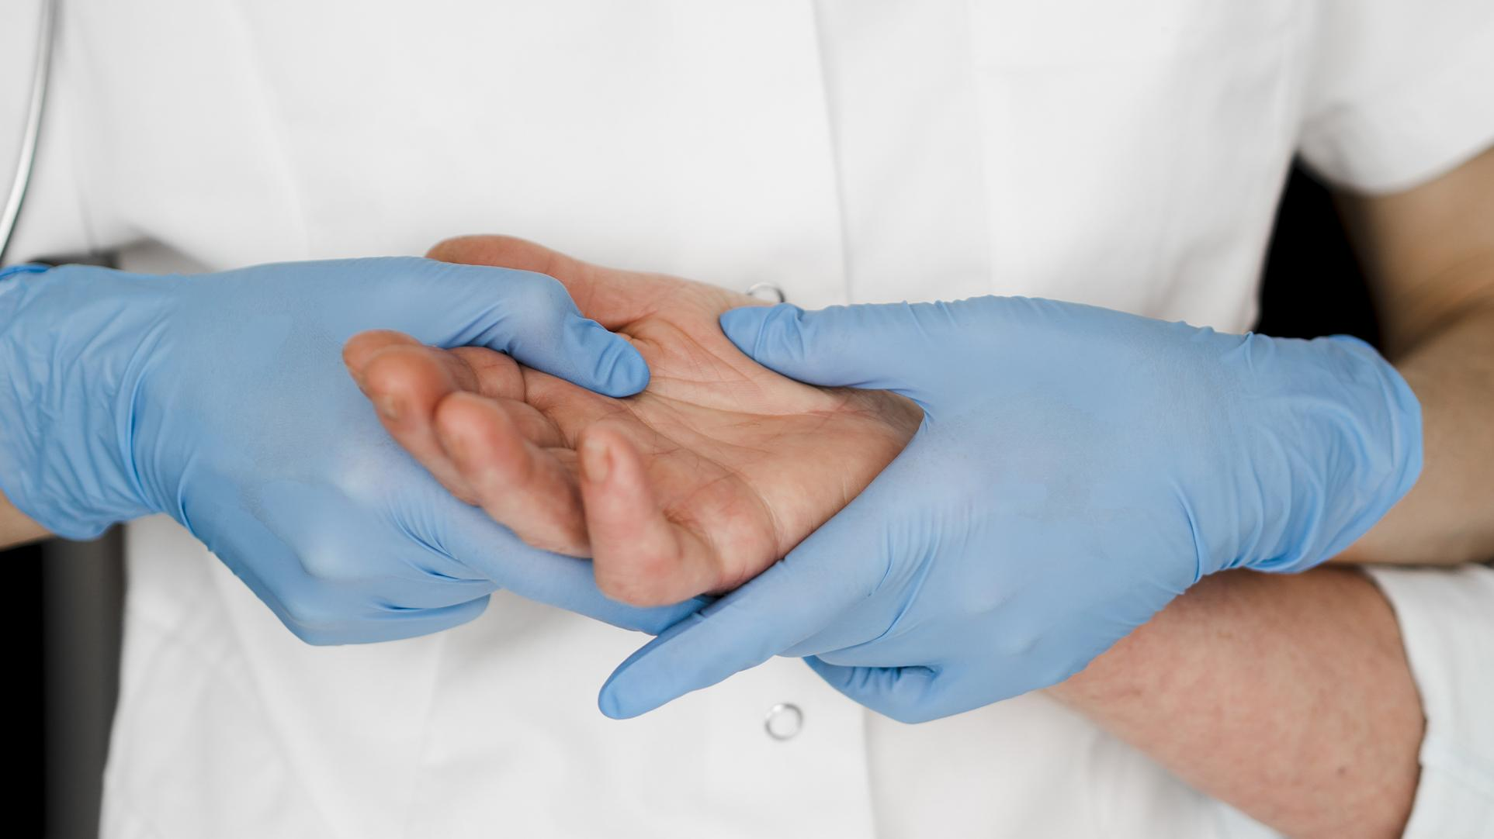
Discussion
The findings of our study have significant implications for cephalometric landmark detection and cephalometric analysis. Firstly, our study demonstrates that machine learning algorithms, particularly the convolutional neural network (CNN) we employed, can offer a fast and accurate alternative to manual detection of cephalometric landmarks. The CNN achieved a mean accuracy of 95.6%, a mean precision of 96.2%, a mean recall of 95.4%, and a mean F1-score of 95.8%. These results indicate that machine learning algorithms can improve the quality and efficiency of cephalometric analysis, providing valuable information for diagnosing and planning orthodontic and oral and maxillofacial surgical treatments.
However, it is important to acknowledge the limitations and challenges of our study. Firstly, the dataset we used was relatively small and may not fully represent the diversity and complexity of real-world cephalometric radiographs. To address this limitation, future research should focus on using larger and more representative datasets to validate and generalize our findings. Additionally, the dataset we used was created by a novice on Kaggle, which may not have followed standard protocols and guidelines for cephalometric landmark annotation. To ensure more reliable and consistent results, it is crucial to use datasets that have been annotated by experts or validated by consensus.

Slide 14
Discussion & Limitations
Another limitation of our study is the lack of demographic and clinical information about the patients, such as age, gender, ethnicity, diagnosis, and treatment plan. Incorporating more informative and comprehensive datasets that include such information can help us better understand the factors that affect cephalometric landmark detection and the implications of this detection for patient diagnosis and treatment.
Furthermore, our classification models did not account for the spatial relationships and dependencies between landmarks, which can impact the accuracy and consistency of landmark detection. Future research should focus on developing more advanced and sophisticated models that can incorporate spatial information and constraints into the landmark detection process.
Additionally, our classification models did not consider the uncertainty and variability of landmark detection, which can affect the reliability and confidence of the results. It is essential to develop more robust and reliable models that can estimate and report the uncertainty and variability of landmark detection results.

Slide 15
Addressing Limitations
To address these limitations and challenges, we propose several future research directions. Firstly, using larger and more representative datasets will help validate and generalize our findings. Secondly, incorporating spatial relationships and dependencies between landmarks into the models will improve accuracy and consistency. Thirdly, developing models that can estimate and report the uncertainty and variability of landmark detection results will enhance reliability and confidence.
In conclusion, our study highlights the potential of machine learning algorithms for cephalometric landmark detection and analysis. While our findings demonstrate promising results, it is important to address the limitations and challenges we encountered. By considering these limitations and proposing future research directions, we can further advance the field of cephalometric landmark detection and improve the diagnosis and treatment of patients with craniofacial disorders.

Slide 16
Results
In our study, we compared the performance of different machine learning algorithms for cephalometric landmark detection. We evaluated the algorithms based on various performance metrics, including accuracy, precision, recall, and F1-score.
The best performing algorithm in our study was a convolutional neural network (CNN). The CNN achieved a mean accuracy of 95.6%, a mean precision of 96.2%, a mean recall of 95.4%, and a mean F1-score of 95.8%. These metrics indicate that the CNN algorithm performed exceptionally well in accurately detecting cephalometric landmarks.
The CNN outperformed the other algorithms in terms of all the metrics & for all the landmarks. It demonstrated the lowest variability & the highest consistency among the algorithms. This suggests that the CNN algorithm is the most suitable & robust approach for cephalometric landmark detection, as it can effectively learn from the data & extract relevant features that are invariant to the cephalometric landmarks.
Therefore, we will highlight the superior performance of the CNN algorithm. We will emphasize its mean accuracy of 95.6%, mean precision of 96.2%, mean recall of 95.4%, and mean F1-score of 95.8%. These results demonstrate the potential of machine learning algorithms, particularly CNNs, in providing a fast and accurate way of cephalometric landmark detection.

Slide 17
Conclusions
The main findings of the study emphasize the potential of machine learning algorithms for cephalometric landmark detection. The study compared the performance of different machine learning algorithms using a dataset of 150 cephalometric radiographs and their corresponding landmark annotations. The best performing algorithm was a convolutional neural network (CNN) with a mean accuracy of 95.6%, a mean precision of 96.2%, a mean recall of 95.4%, and a mean F1-score of 95.8%. These results demonstrate that machine learning algorithms, particularly CNNs, can provide a fast and accurate way of detecting cephalometric landmarks.
The research contributes to the field of cephalometric landmark detection and cephalometric analysis by providing a comprehensive comparison of different machine learning algorithms. It identifies the best performing algorithm and highlights its superior performance in accurately detecting landmarks. The study also provides insights into the factors that affect the performance of machine learning algorithms and the challenges that need to be addressed in this field.
Additionally, the research suggests future research directions, such as using larger and more representative datasets, incorporating spatial relationships and uncertainty estimation, and considering feedback and correction mechanisms from human experts. Overall, the study advances the knowledge and practice in cephalometric landmark detection and analysis, potentially improving the diagnosis and treatment of patients with craniofacial disorders.

Slide 18
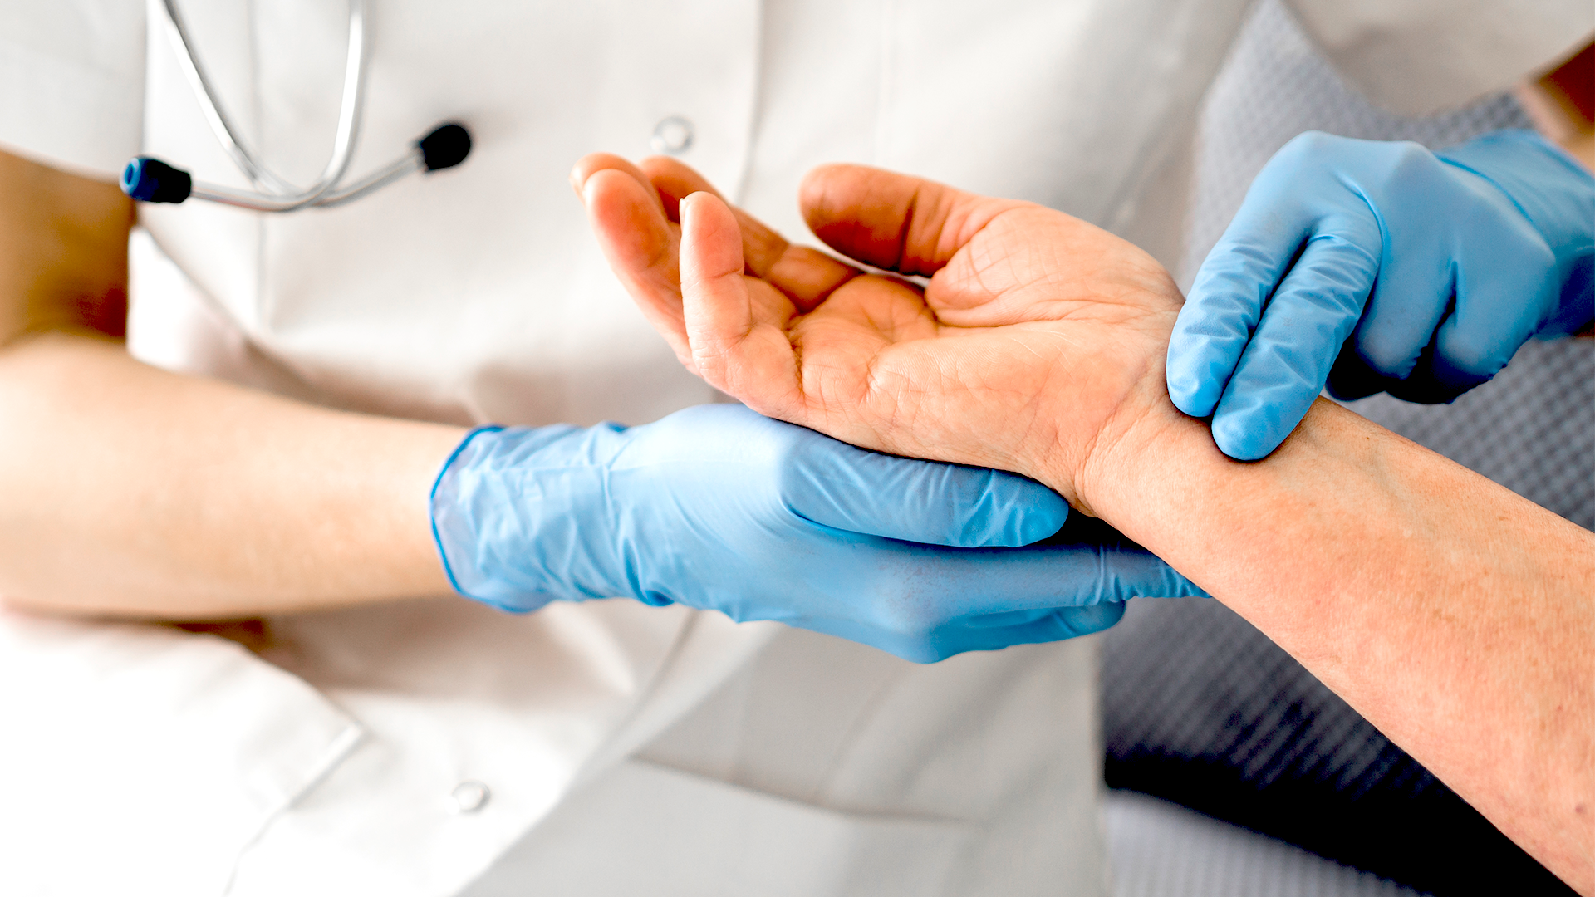
References (Included in detail in project report)
Mamta Juneja, Poojita Garg, Ravinder Kaur, Palak Manocha, Prateek, Shivam Batra, Pradeep Singh, Shaswat Singh, Prashant Jindal. "A review on cephalometric landmark detection techniques." 2021.
Falk Schwendicke, Akhilanand Chaurasia, Lubaina Arsiwala, Jae-Hong Lee, Karim Elhennawy, Paul-Georg Jost-Brinkmann, Flavio Demarco & Joachim Krois. "Deep learning for cephalometric landmark detection: systematic review and meta-analysis." 2021.
Nuha Junaid, Niha Khan, Naseer Ahmed, Maria Shakoor Abbasi, Gotam Da, Afsheen Maqsood, Abdul Razzaq Ahmed, Anand Marya, Mohammad Khursheed Alam and Artak Heboyan. "Development, Application, and Performance of Artificial Intelligence in Cephalometric Landmark Identification and Diagnosis: A Systematic Review." 2022.
S. Rashmi, S. Srinath, Karthikeya Patil, Prashanth Sadashiva Murthy & Seema Deshmukh. "Lateral Cephalometric Landmark Annotation Using Histogram Oriented Gradients Extracted from Region of Interest Patches." 2023.
Suvarna Indermun, Bachelor of Dental Surgery, Shoayeb Shaik, Clement Nyirenda, Keith Johannes, Riaan Mulder. "Human examination and artificial intelligence in cephalometric landmark detection—is AI ready to take over?" 2023.
Young Hyun Kim, Chena Lee, Eun-Gyu Ha, Yoon Jeong Choi, and Sang-Sun Han. "A fully deep learning model for the automatic identification of cephalometric landmarks." 2021.
Yankai Jiang, Yiming Li, Xinyue Wang, Yubo Tao, Jun Lin & Hai Lin. "CephalFormer: Incorporating Global Structure Constraint into Visual Features for General Cephalometric Landmark Detection." 2022.
Rabie A. Ramadan, Ahmed Y. Khedr, Kusum Yadav, Eissa Jaber Alreshidi, Md Haidar Sharif, Ahmad Taher Azar & Hiqmet Kamberaj. "Convolution neural network based automatic localization of landmarks on lateral x-ray images." 2022.
Dr. Shubhangi Mani, Dr. Ravindra Manerikar, Dr. Amit Mani, Dr. Shivani Sachdeva, Dr. Abhay Paul Arimbur, Dr. Sumeet Mishra. "Automated Cephalometric Landmarking Using Artificial Intelligence - A Systematic Review." 2020.
E.N.D. Goutham, Srikanth Vasamsetti, P.V.V. Kishore, H.K. Sardana. "Automatic Localization Of Landmarks In Cephalometric Images Via Modified U-Net." 2019.
Shtwai Alsubai. "A Critical Review on the 3D Cephalometric Analysis Using Machine Learning." 2022.
Mamta Juneja, Sumindar Kaur Saini, Harleen Kaur, Rishabh Verma, Prashant Jinda. "CephaloNet: A Deep Learning based automatic landmark detection system for cephalometric X-ray images." 2023.

